Slide 1
HR DATA ANALYSIS
Digital Egypt Pioneers Initiative – DEPI
Instructor : Jackie Abualeam
Hady Mohamed Kilany Mohamed

Slide 2
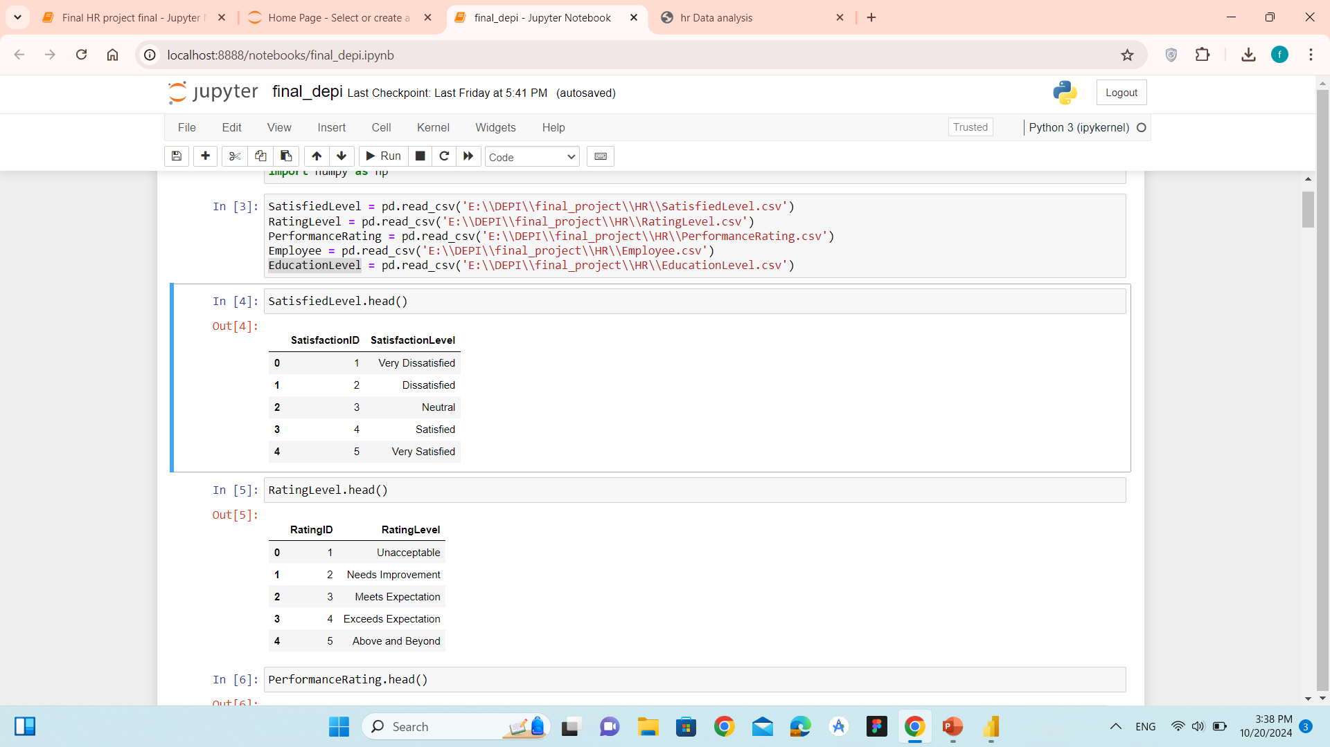
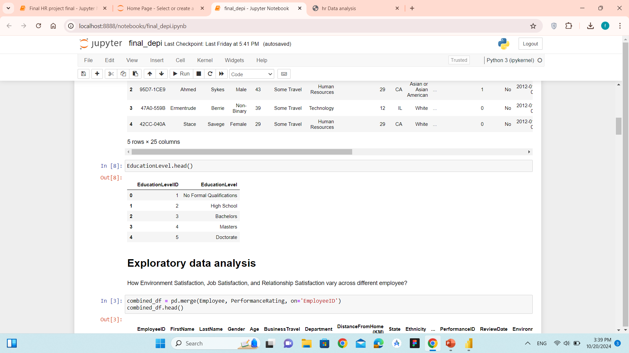
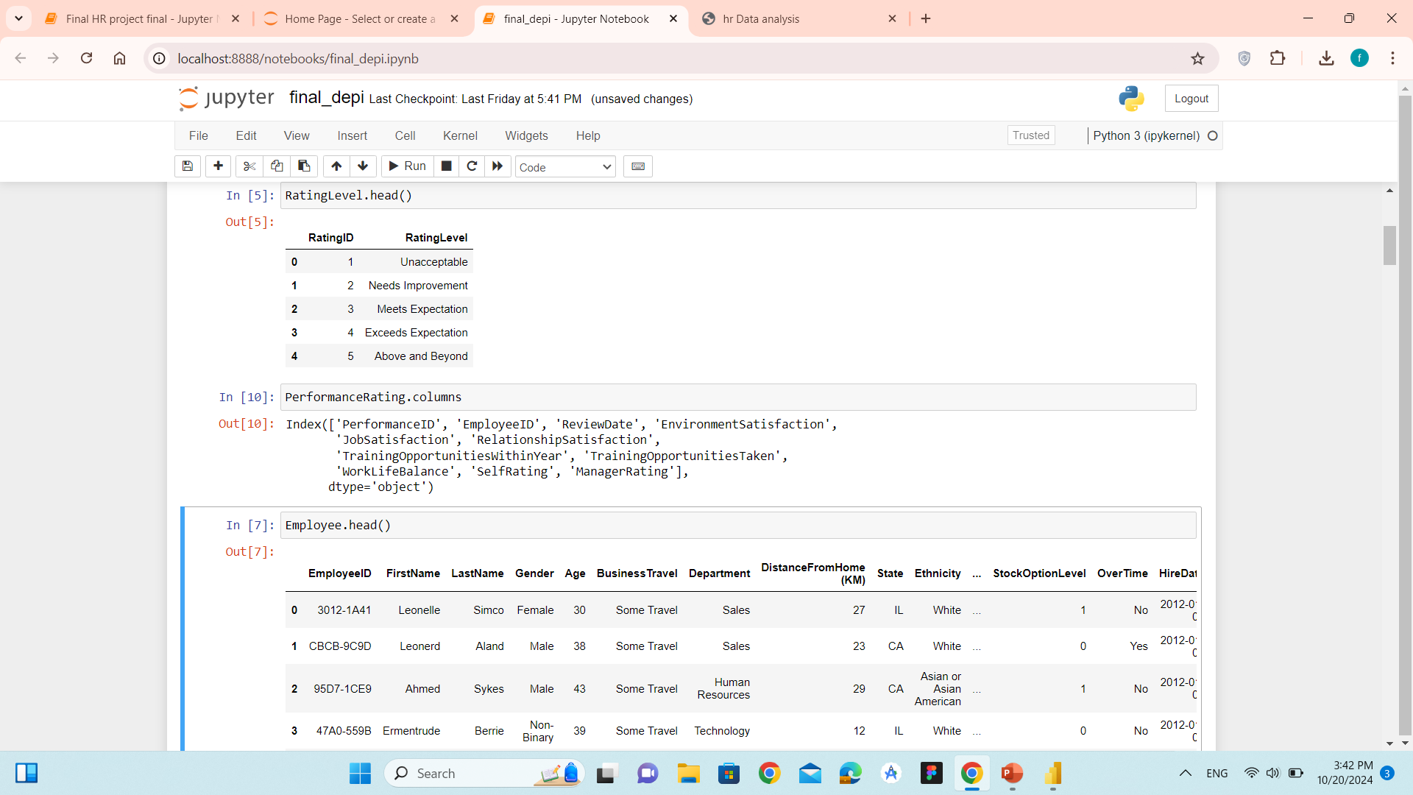
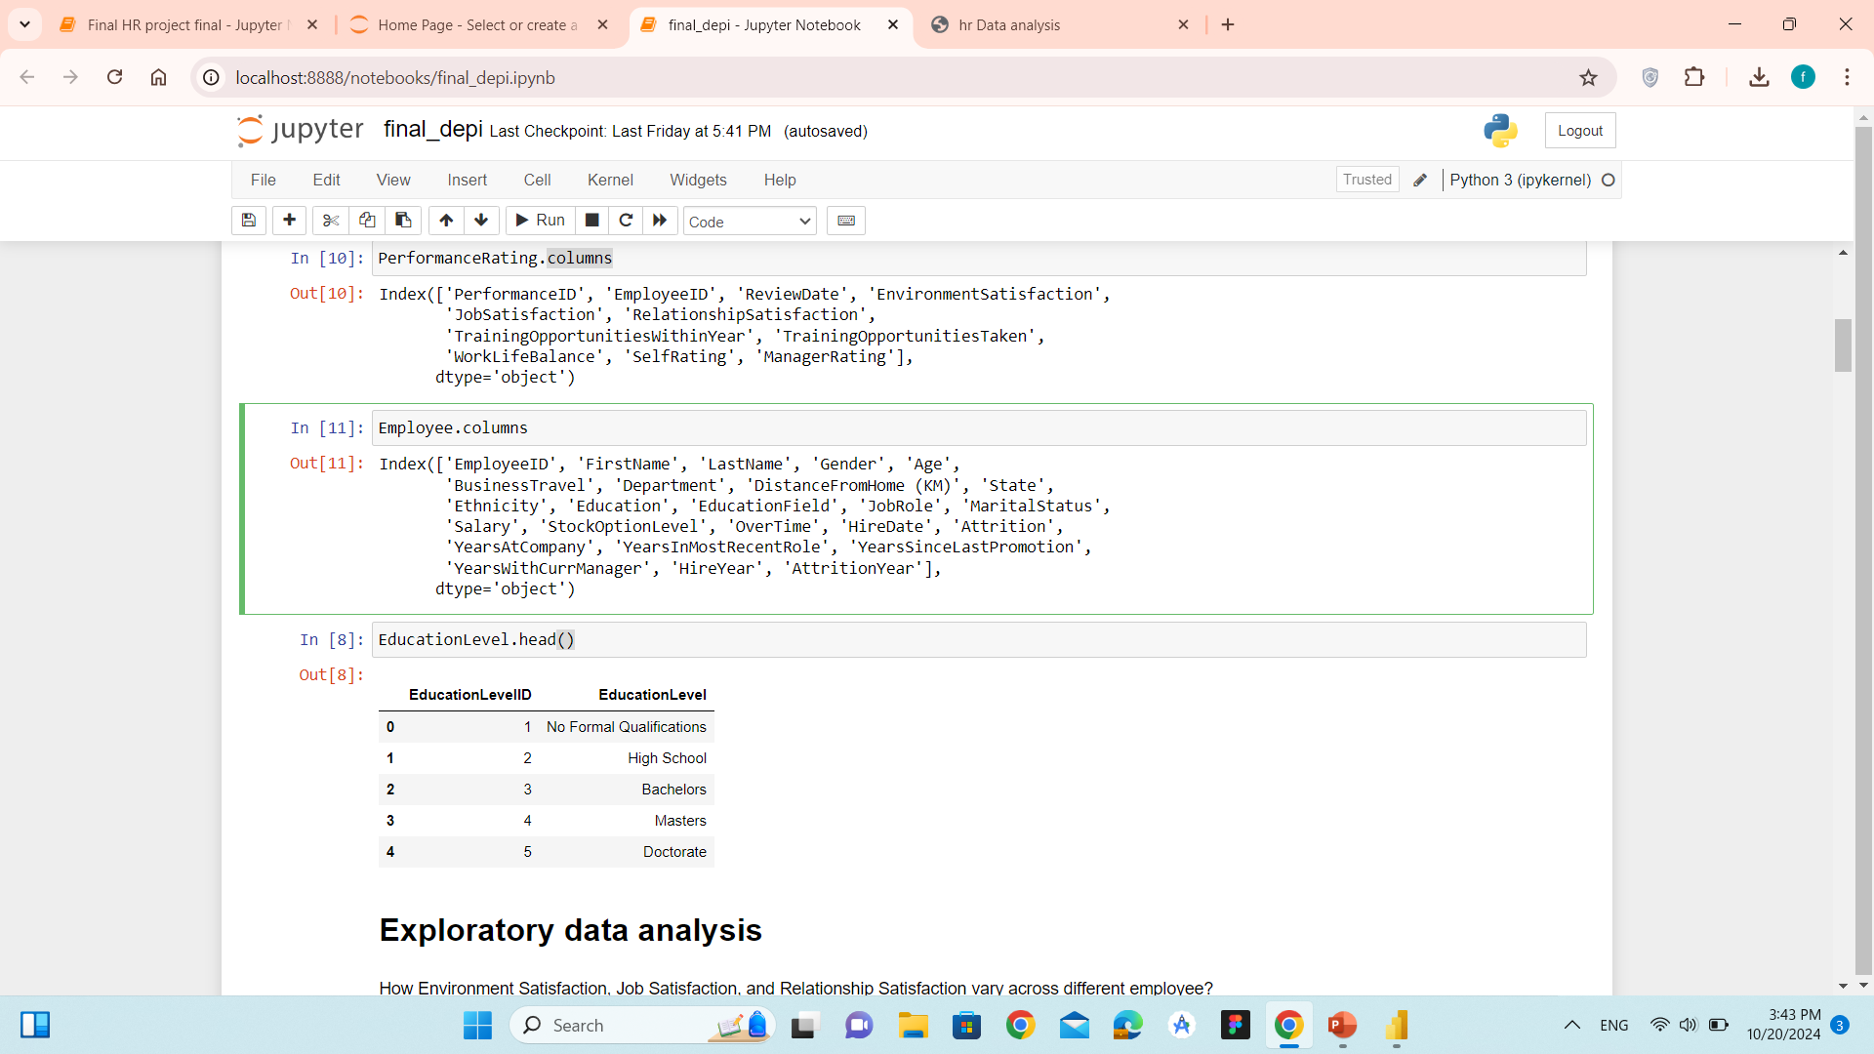
About Data
Satisfied Level
Rating Level
Education Level
Performance Rating Level
Employee

Slide 3
Data Preprocessing with Python

Slide 4
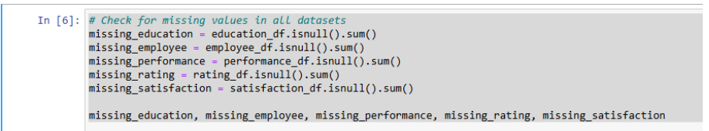
Data Loading and Initial Exploration
we load the datasets for education levels, employee information, performance ratings,
and satisfaction levels. After loading, we explore the data to check its structure,
identify missing values, and find unique entries in key columns.
Checking for Missing Values
We checked each dataset for missing values using isnull().sum(). Fortunately,
there were no missing values in any of the datasets, ensuring data integrity and
reducing the need for imputation.

Slide 5
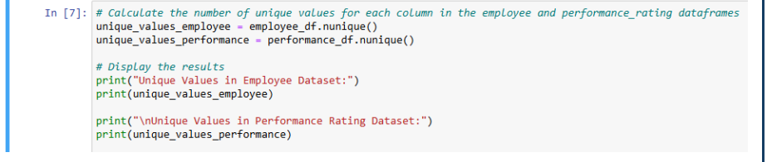
Identifying Unique Values
To understand the variety of data, we calculated the number of unique values for each column in the employee and performance rating datasets. This step helps identify categorical variables and spot potential anomalies in the data.

Slide 6
Preprocessing Steps
Removing Spaces from the 'Education Field' Column
Objective: To ensure that any leading or trailing spaces in the 'Education Field’ column are removed for accurate analysis and comparisons
Verifying Unique Values
Objective: To check the unique values in the 'Education Field' column after removin
spaces, ensuring that the preprocessing step was successful.
Calculating Attrition Year
Objective: To calculate the year in which an employee is expected to leave the company
based on their hire date and the number of years they have been with the company.
Dropping Outdated Performance Ratings
Objective: To ensure that performance ratings are relevant by removing any ratings that fall outside the expected date range based on the calculated 'Attrition Year’.

Slide 7
Converting Review Date to Datetime
Objective: To convert the 'Review Date' column in the performance rating data frame to a datetime format , facilitating date comparisons.
Merging Employee and Performance Data
Objective: To merge the employee data frame with the performance data frame, incorporating hire and
attrition years for each employee
Filtering Performance Reviews by Date Range
Objective: To calculate the year in which an employee is expected to leave the company
based on their hire date and the number of years they have been with the company.
Dropping Unnecessary Columns
Objective: To remove extra columns ('Hire Year' and 'Attrition Year') from the filtered performance data frame, simplifying the dataset.

Slide 8
Data Exploration with SQL

Slide 9
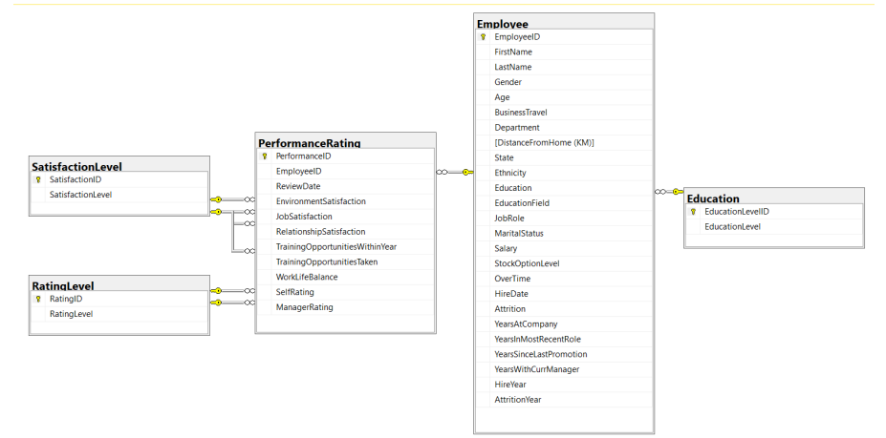

Slide 10
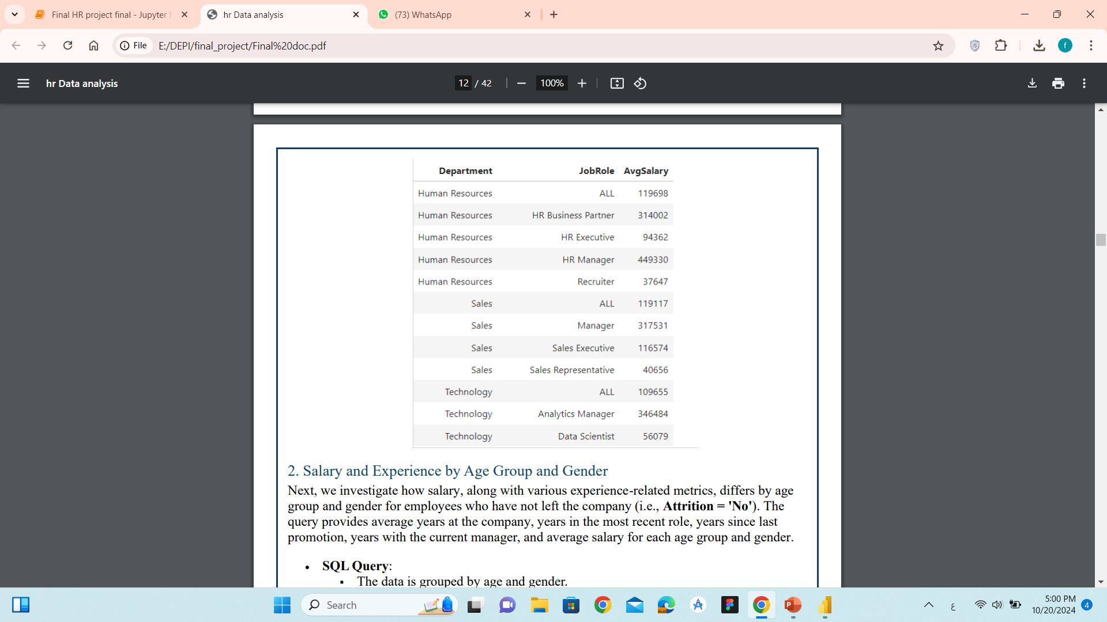
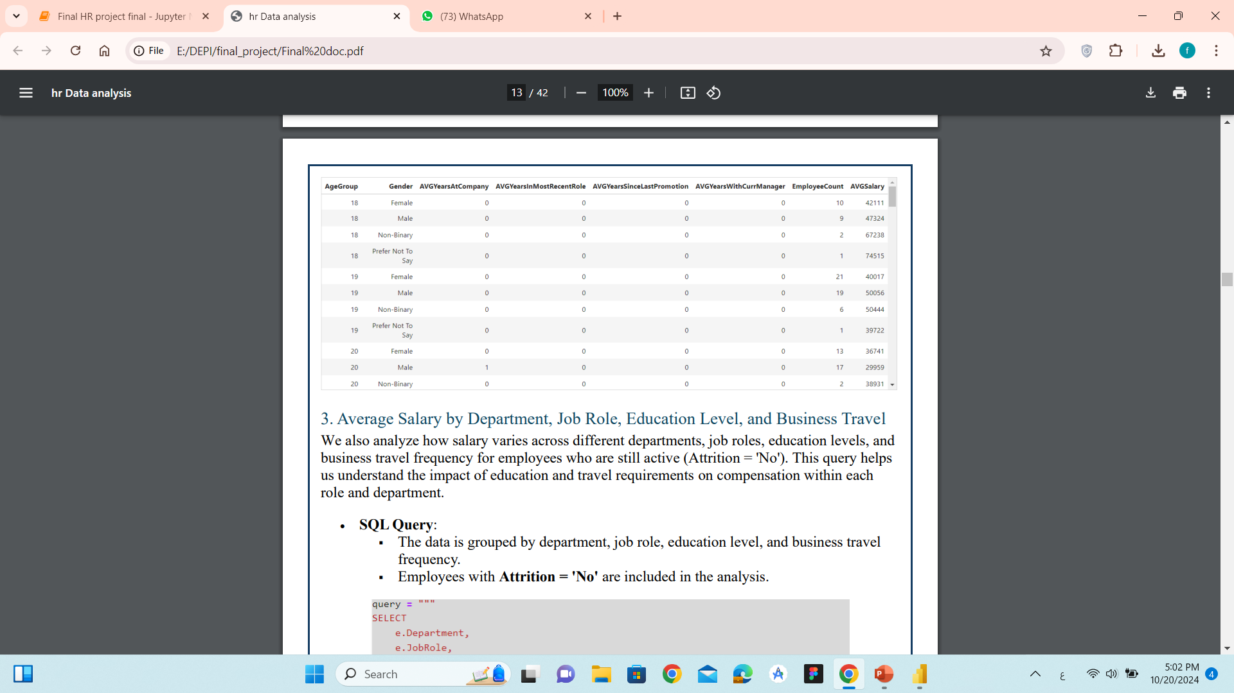
Salary Insights
Average Salary by Department
and Job Role
Salary and Experience by Age Group and Gender

Slide 11
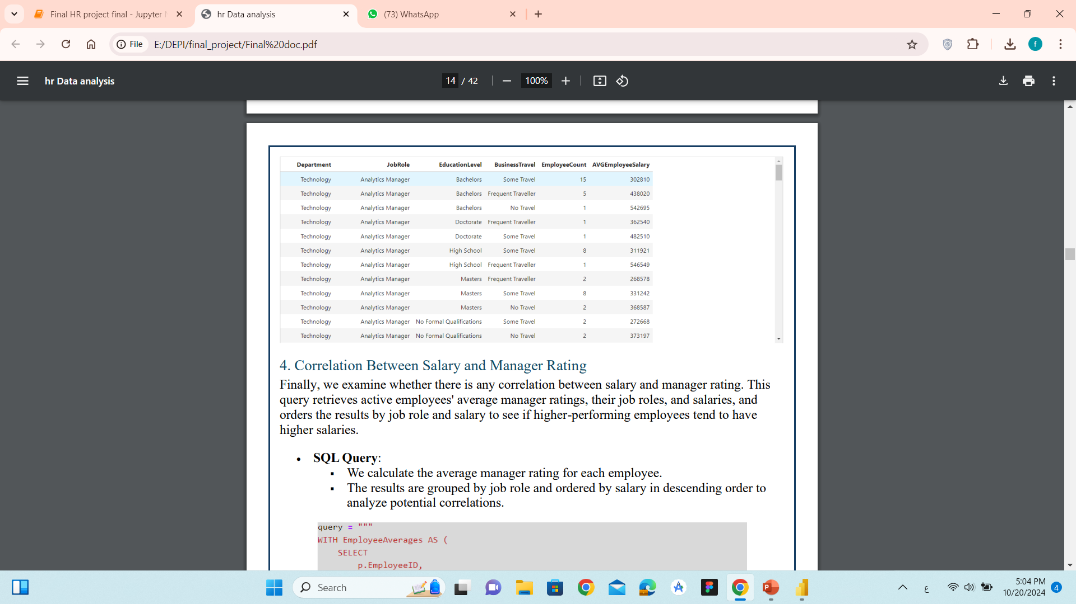
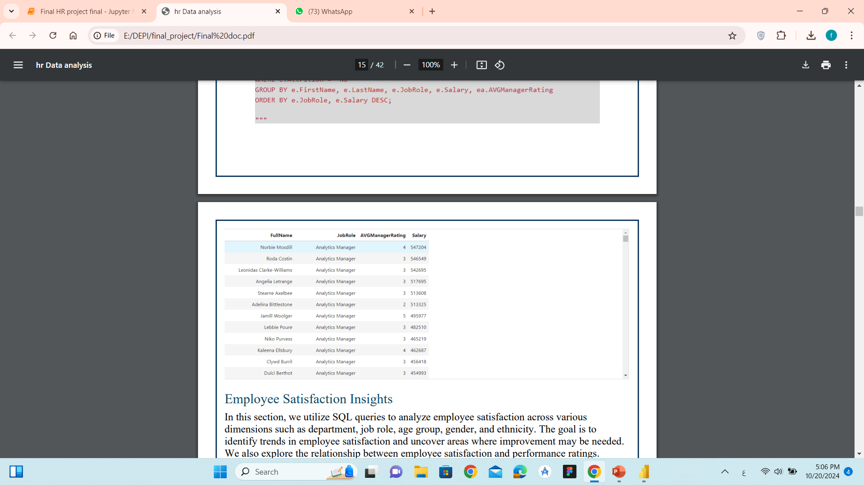
Average Salary by Department, Job Role,
Education Level, and Business Travel
Correlation Between Salary
and Manager Rating

Slide 12
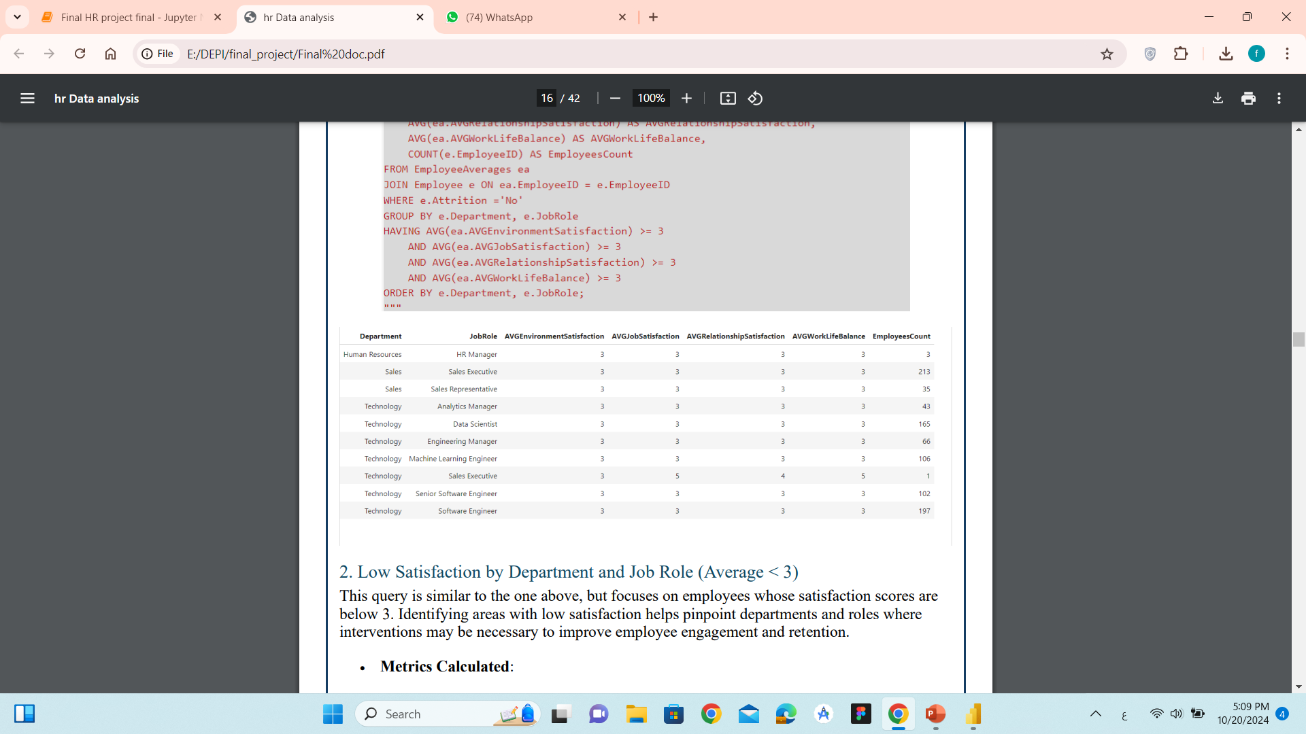
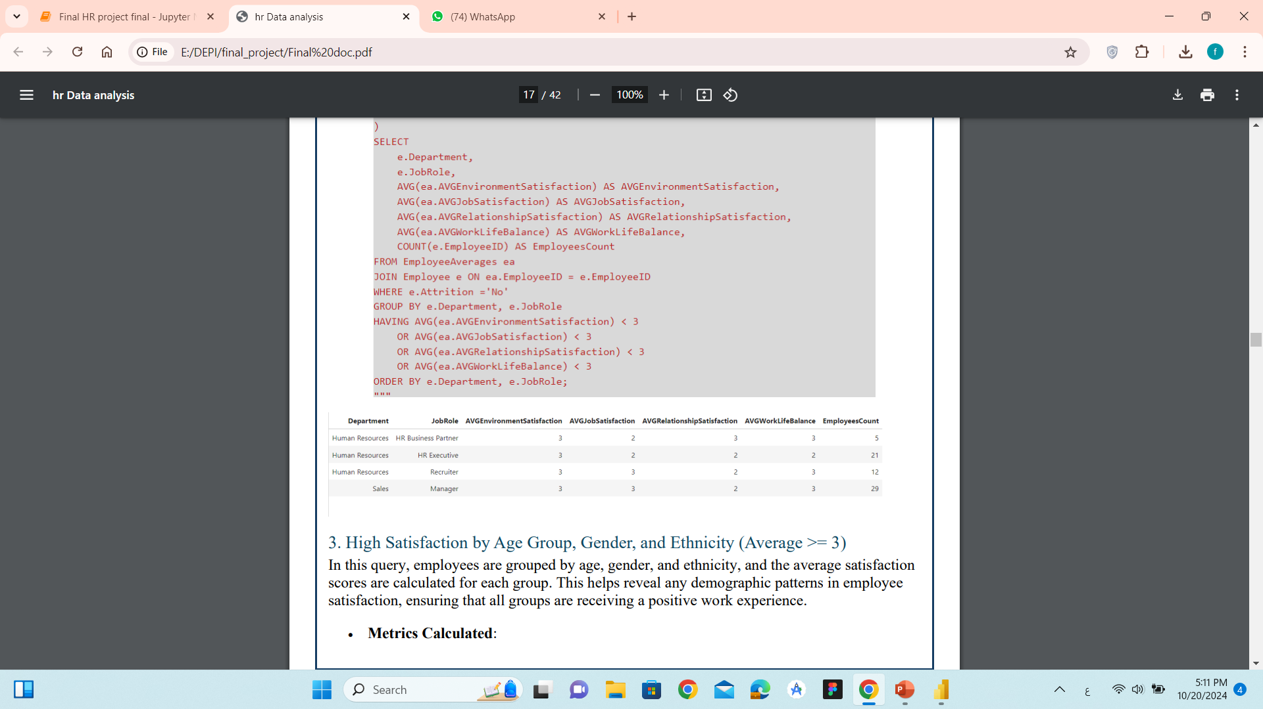
Employee Satisfaction Insights
High Satisfaction by Department and Job Role (Average >= 3)
Low Satisfaction by Department and Job Role (Average < 3)

Slide 13
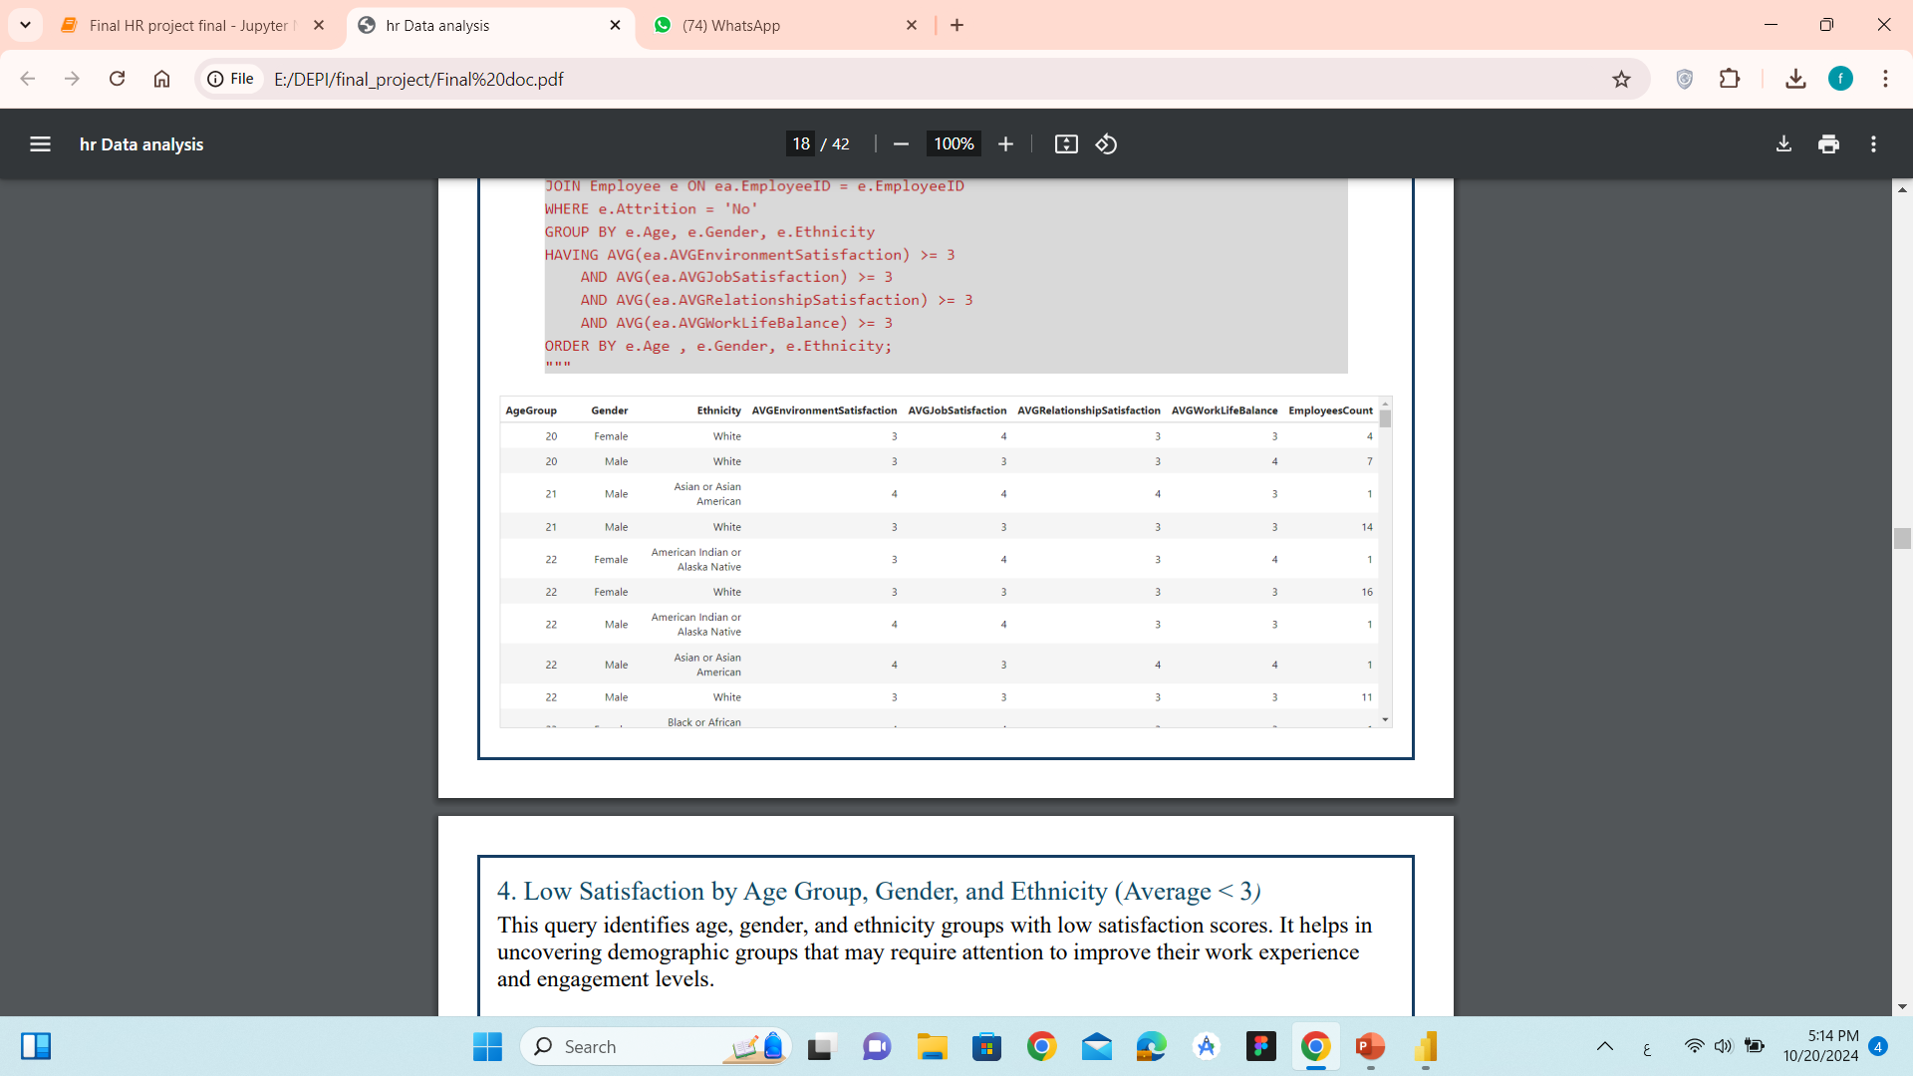
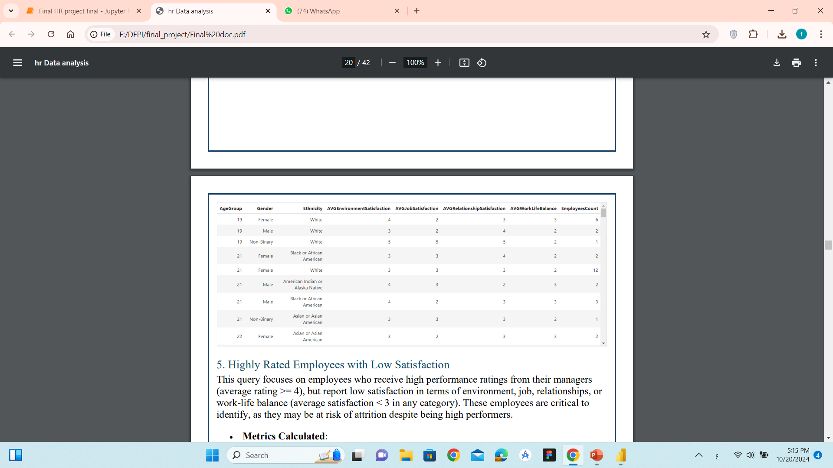
High Satisfaction by Age Group, Gender, and Ethnicity (Average >= 3)
Low Satisfaction by Age Group, Gender, and Ethnicity (Average < 3)

Slide 14
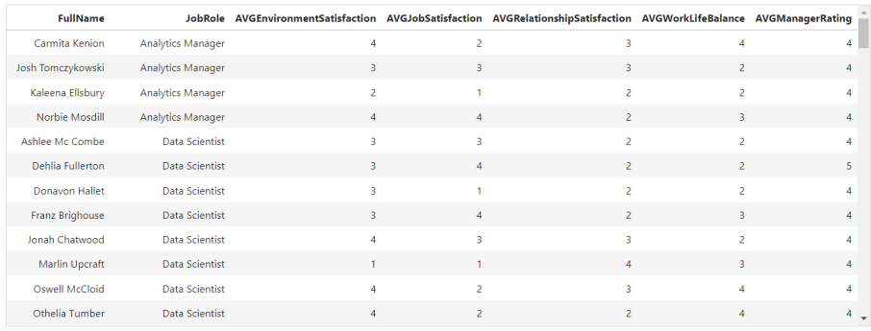
Highly Rated Employees with Low Satisfaction

Slide 15
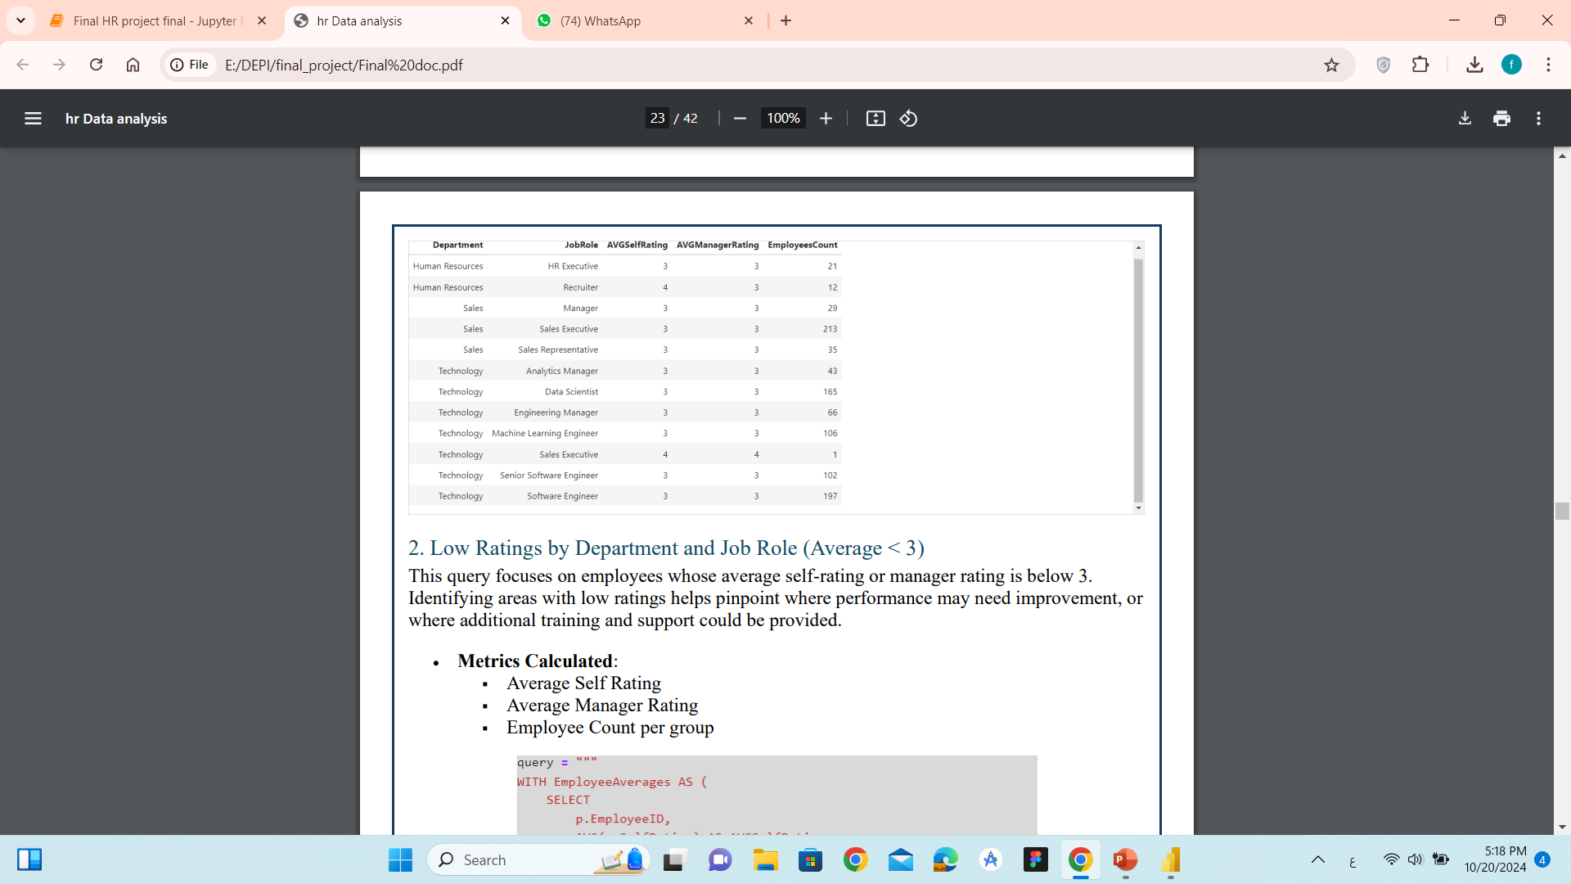
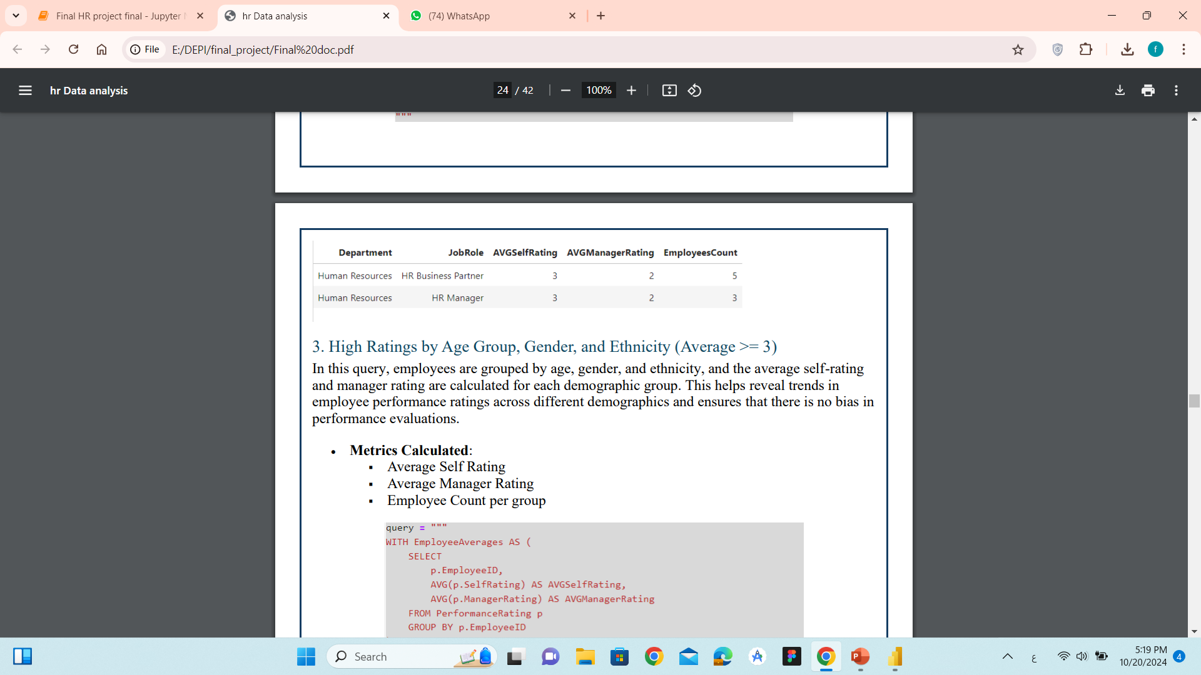
Employee Rating Insights
High Ratings by Department
and Job Role (Average >= 3)
Low Ratings by Department
and Job Role (Average < 3)

Slide 16
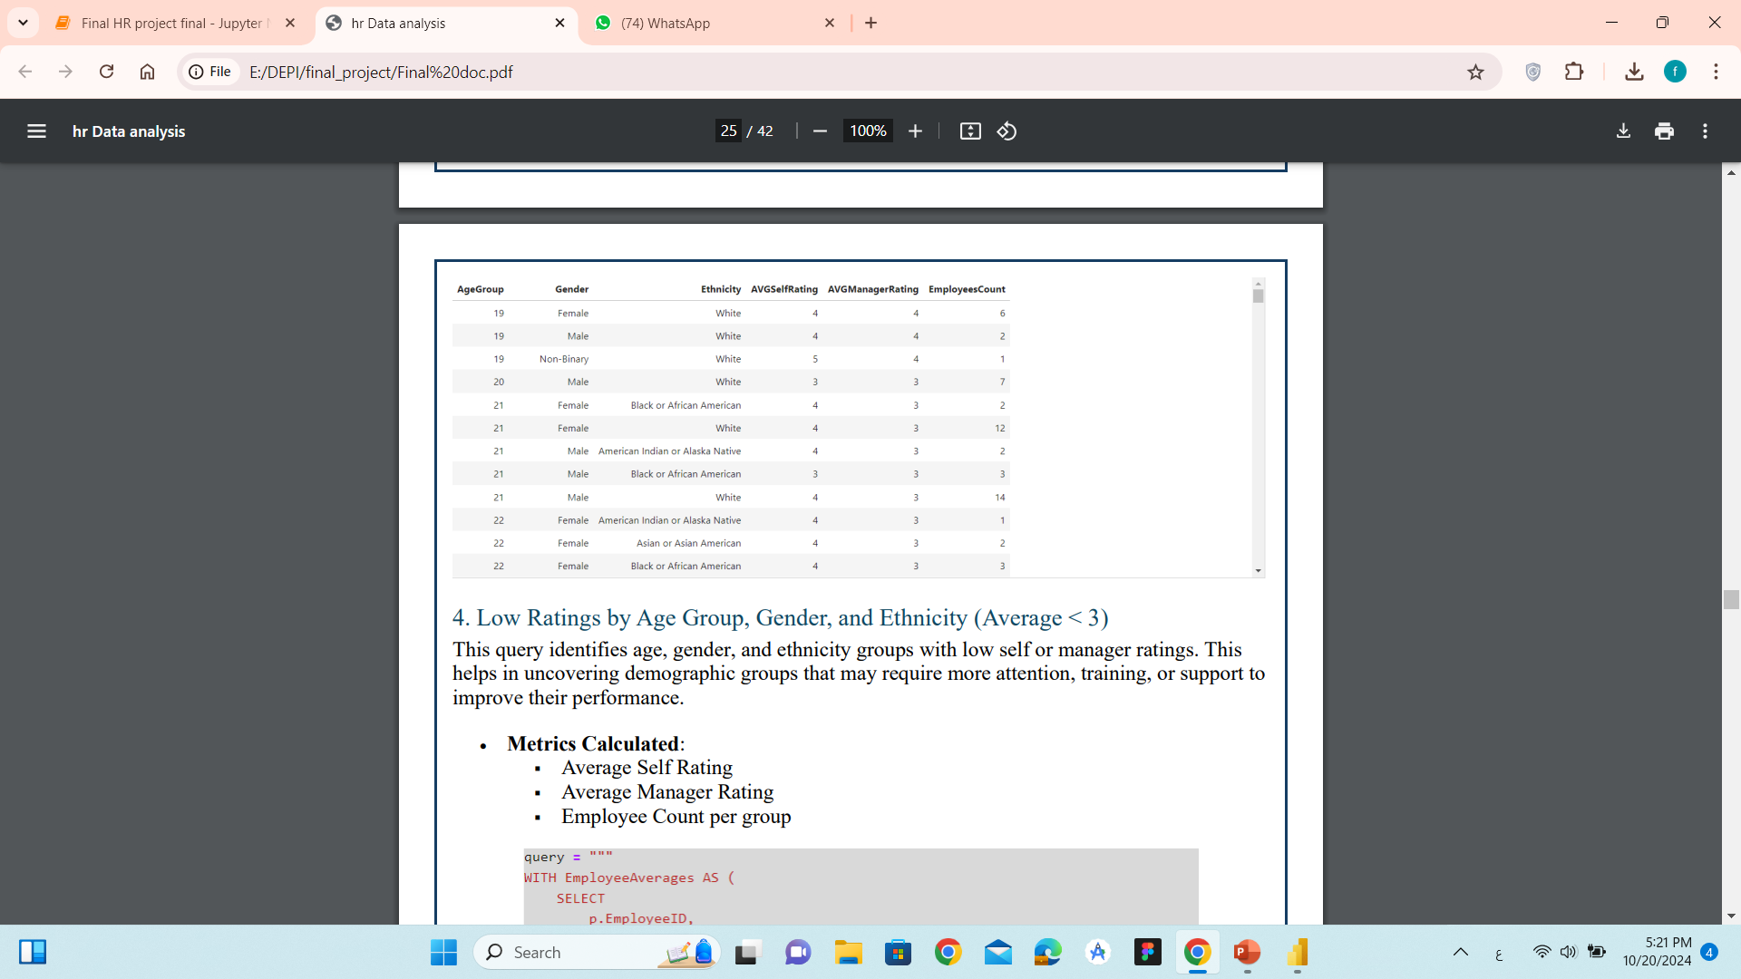
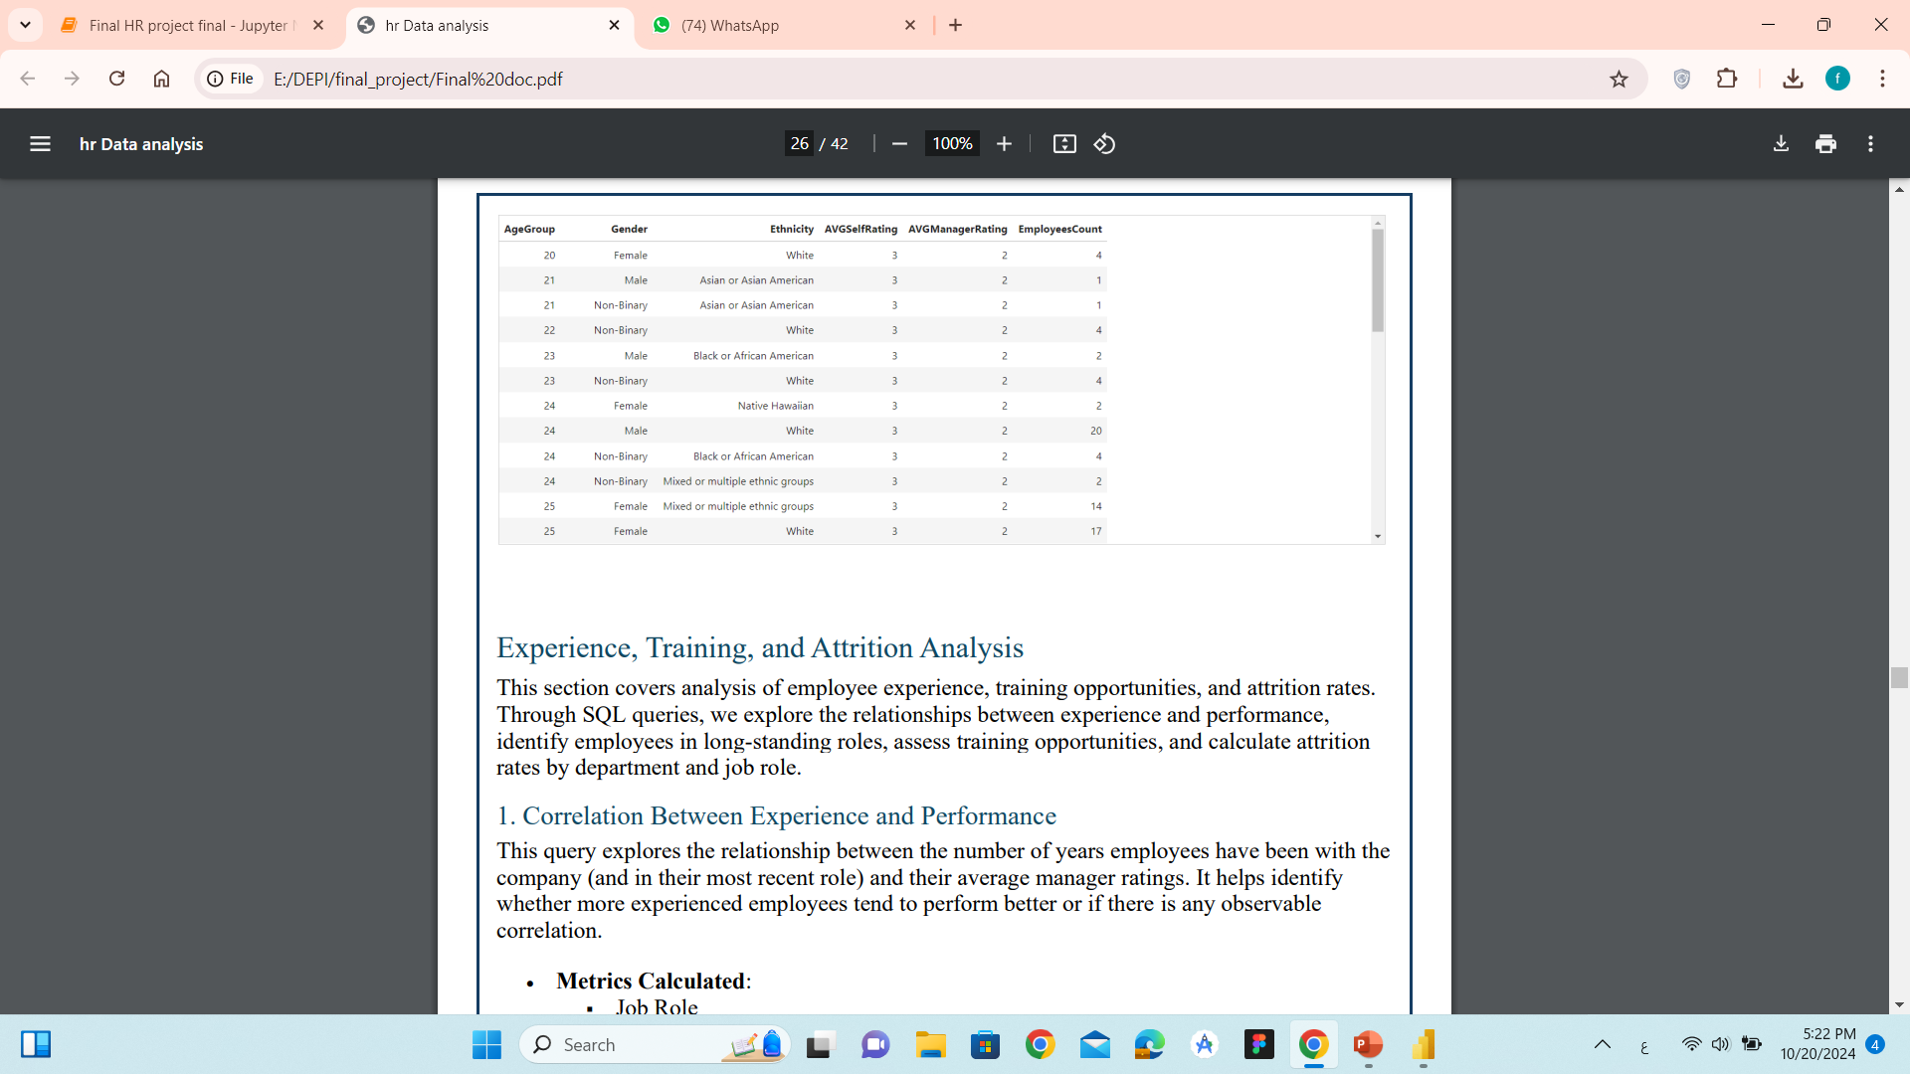
High Ratings by Age Group,
Gender, and Ethnicity (Average >= 3)
Low Ratings by Age Group,
Gender, and Ethnicity (Average < 3)

Slide 17
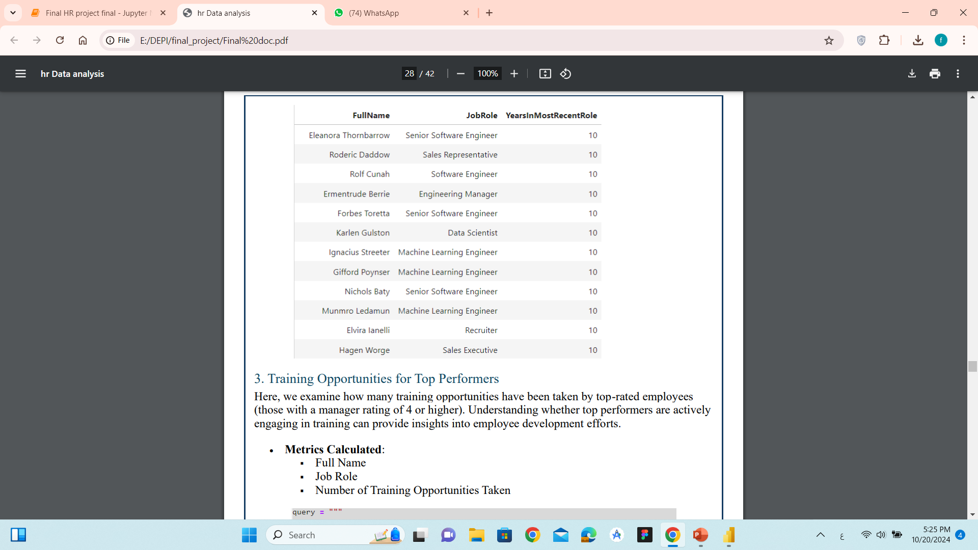
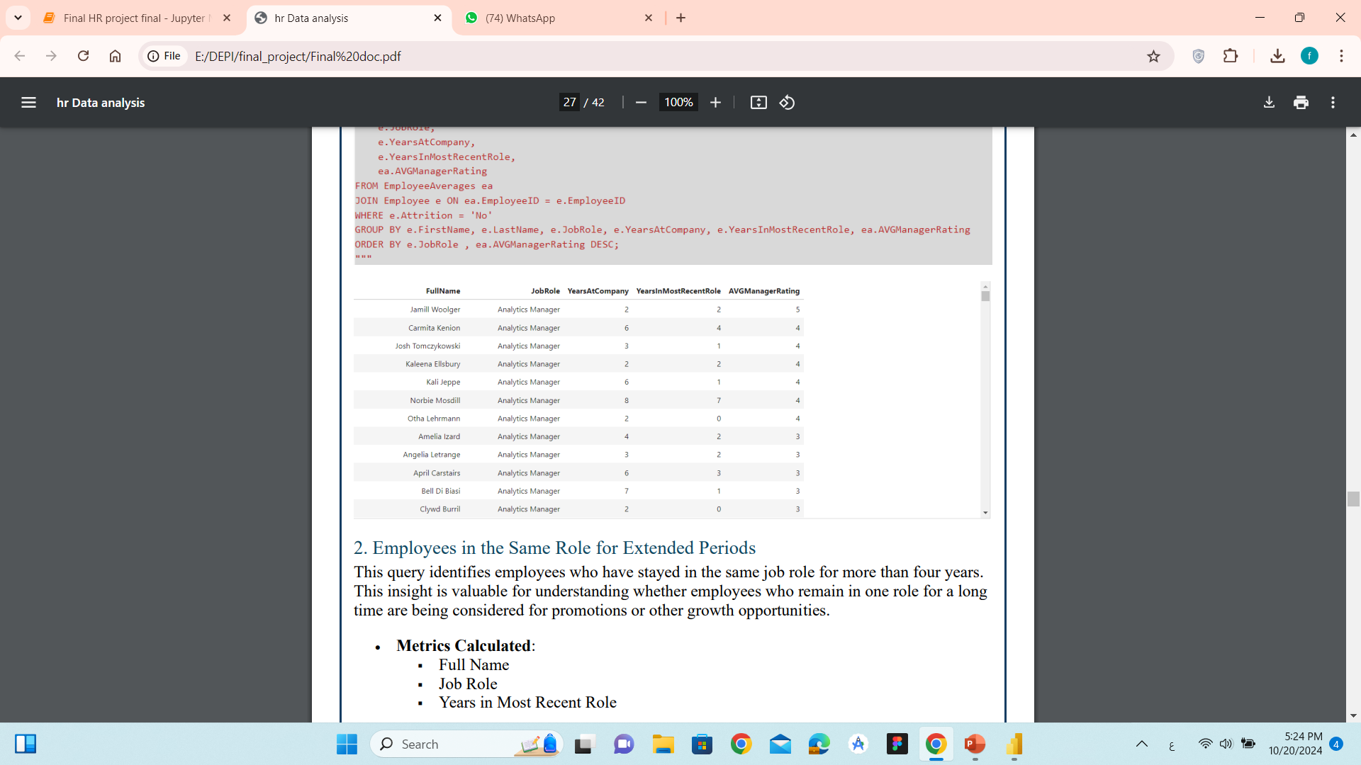
Experience, Training, and Attrition Analysis
Correlation Between Experience
and Performance
Employees in the Same Role
for Extended Periods

Slide 18
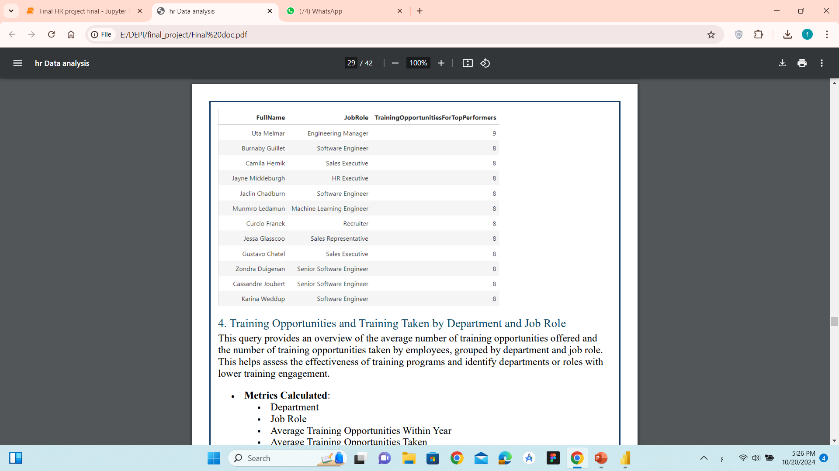
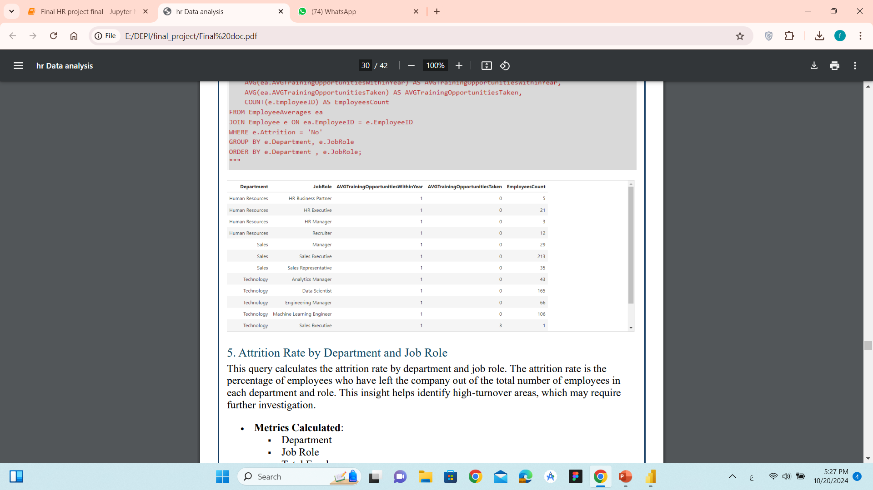
Training Opportunities for
Top Performers
Training Opportunities and Training
Taken by Department and Job Role

Slide 19
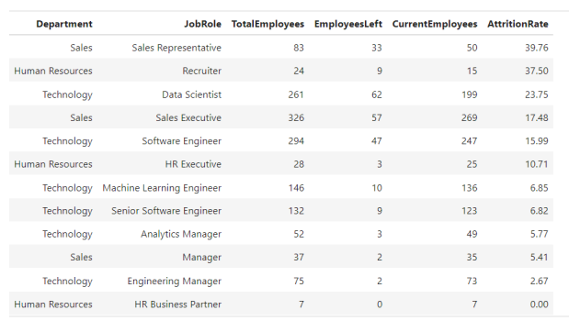
Attrition Rate by Department and Job Role

Slide 20
Visualization data driven insights with Power Bi

Slide 21
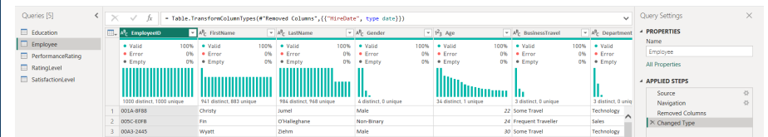
Step1: Connecting Power BI to SQL Server and Data Transformation
Connecting Power BI to SQL Server\
The initial step in this project involves connecting Power BI to a SQL Server database to load the HR datasets. By establishing this connection, we can pull the necessary data directly from SQL Server and ensure that the data is updated in real time when needed.
Data Transformation with Power Query

Slide 22
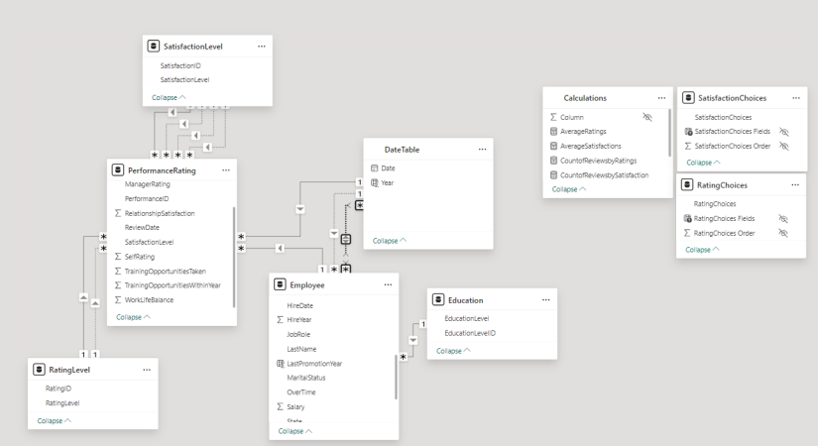
Step 2 : Data Modeling and Calculations in Power BI
Creating the Data Model and Connecting Tables
This step allows for seamless data retrieval and interaction across different datasets, such as employee information, satisfaction levels, and performance ratings.

Slide 23
Creating a Date Table
A Date Table is crucial for time-based analysis, enabling insights into trends over time (e.g.,
performance ratings or satisfaction scores over the years). It also helps with time intelligence
Calculations
Date Table Relationships:
Active One-to-Many Relationship with ReviewDate in PerformanceRating Table
Inactive One-to-Many Relationship with HireDate in Employee Table
Inactive Many-to-Many Relationship with LastPromotionYear in Employee Table

Slide 24
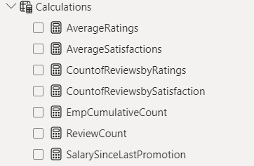
Creating a Calculations Table for Measures
A Calculations Table is used to store all custom measures and calculations in a single place,
keeping the data model organized. These measures are critical for performing more advanced
analysis.

Slide 25
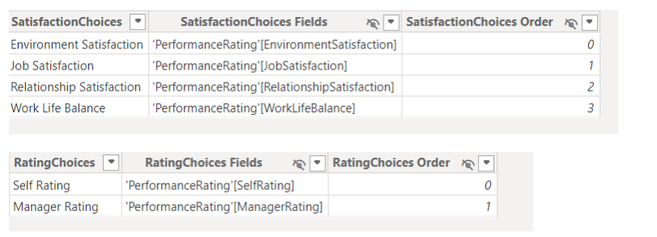
Creating Parameters for Slicers (Satisfaction and Ratings)
To allow users to dynamically filter the data based on employee satisfaction type and different
performance rating, we create parameters for these metrics and link them to slicers in the
dashboard.

Slide 26
Step 3: Creating an Interactive Dashboard with Multiple Views
Creating Multiple Views
The dashboard features three distinct views that provide comprehensive insights into the HR
data:
• Employee Overview
• Satisfaction Overview
• Ratings Overview
Switching Views Using Buttons
Adding Reset Buttons
Final Dashboard Design

Slide 27
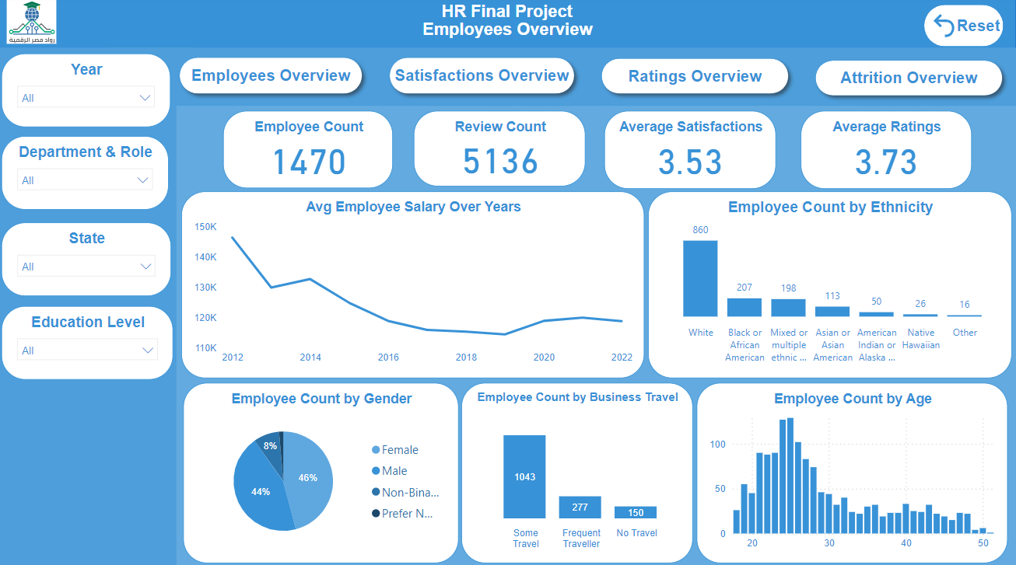

Slide 28
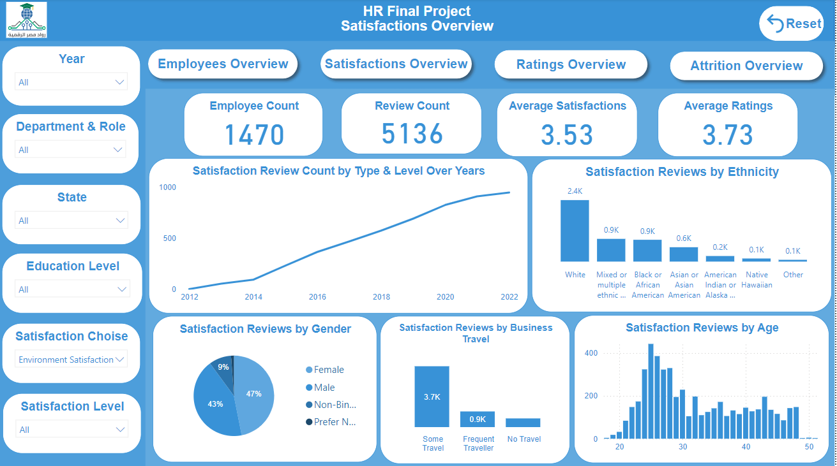

Slide 29
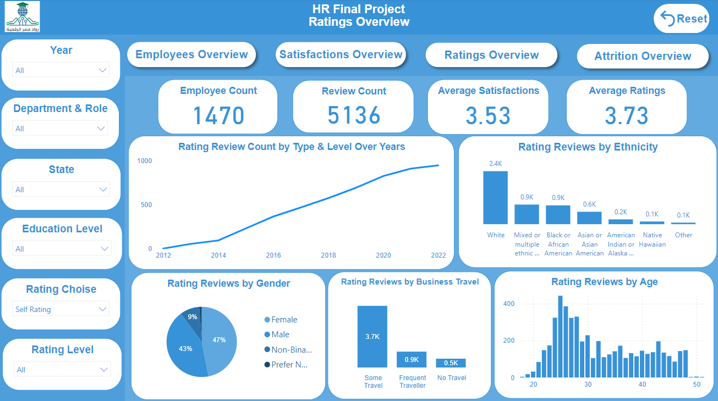

Slide 30
